Slide 1
Requirement Engineering

Slide 2
Software requirements
requirements: specify what to build
tell "what" and not "how"
tell the system design, not the software design
tell the problem, not the solution (in detail)
What are some goals of doing requirements?
understand precisely what is required of the software
communicate this understanding precisely to all development parties
control production to ensure that system meets specs (including changes)

Slide 3
Stakeholders
Anyone who operates the system
(normal and maintenance operators)
Anyone who benefits from the system
(Functional, political, financial and social beneficiaries)
Anyone involved in purchasing or procuring the system

Slide 4
Requirement roles to people
Roles of requirements
Customers: show what should be delivered; contractual base
Managers: a scheduling / progress indicator
Designers: provide a spec to design
Coders: list a range of acceptable implementations / output
QA / Testers: provide a basis for testing, validation, and verification

Slide 5
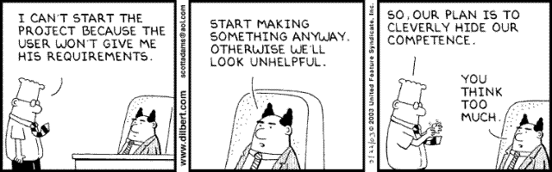
Requirements Gathering
How do we find out what we are supposed
to be building?

Slide 6
Why good Specs are Essential:
$
It is VERY expensive to fix problems late in the process. It is very cheap to rewrite or clarify a written spec.
What costs $1 to fix at ReqGathering
$5 in the design stage
$10 in the coding stage
$20 in the unit testing phase
$200 after delivery

Slide 7
Starter Questions
What is a "requirement"?
How do we determine the requirements?

Slide 8
Types of Requirements
Functional
ex - it must email the sales manager when an inventory item is "low"
Non-Functional
ex - it must require less than one hour to run
Explicit
ex – required features
Implied
ex – software quality
Forgotten
ex – exists in current process
Unimagined

Slide 9
Functional requirements
Examples of functional requirements:
The user shall be able to search either all of the initial set of databases or select a subset from it.
The system shall provide appropriate viewers for the user to read documents in the document store.
Every order shall be allocated a unique identifier (ORDER_ID) which the user shall be able to copy to the account’s permanent storage area.

Slide 10
Non-functional requirements
Examples of non-functional requirements:
It shall be possible for all necessary communication between the APSE and the user to be expressed in the standard ASCII character set.
The system development process and deliverable documents shall conform to the process and deliverables defined in XYZCo-SP-STAN-95.
The system shall not disclose any personal information about customers apart from their name and reference number to the operators of the system.

Slide 11
Questions
What makes a particular requirement good or bad?
Why is requirements engineering difficult?

Slide 12
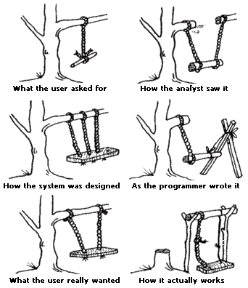
Requirements of Requirements
Clear
Measurable
Feasible
Necessary
Prioritized
Concise

Slide 13
Req Gathering Problems
Accommodating changing reqs
Being complete, without being constraining
Conflicting views
Ease of omitting obvious info
Identifying the experts and getting authority to talk to people
Incomplete understanding of the problem on the part of the user/customer
Sticking with “what” and not “how”
Determining what is critical

Slide 14
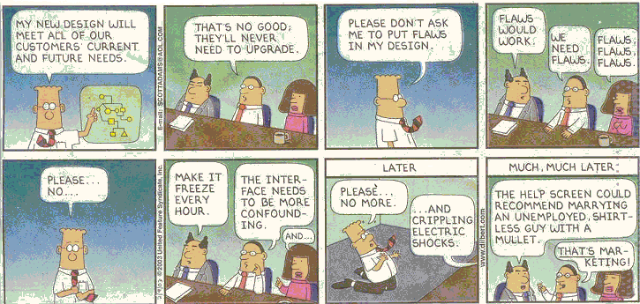
Requirements WILL Change

Slide 15
Requirements Analysis: definitions
‘The process of establishing the services the system should provide and the constraints under which it must operate’
Roger S. Pressman Software Engineering – A practitioner’s Approach European Adaptation, fifth edition
‘The appropriate mechanism for understanding what the customer wants, analyzing need, assessing feasibility, negotiating a reasonable solution, specifying the solution unambiguously, validating the specification, and managing the requirements as they are transformed into an operational system’
Thayer, R.H. and M. Dorfman, Software requirements engineering

Slide 16
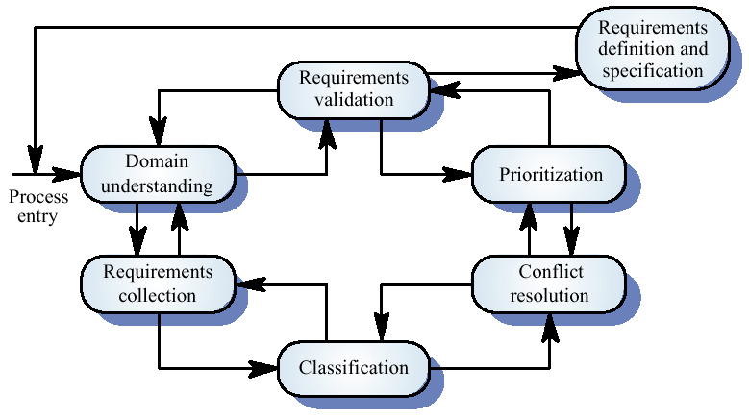
The requirements analysis process

Slide 17
Process activities
Domain understanding
Requirements collection
Classification
Conflict resolution
Prioritisation
Requirements checking

Slide 18
Why so difficult?
Users/stakeholders
Interaction….match
Software designer
Different “worlds”
using vs designing something
knowing what should be done vs knowing to let a computer do that
Users/stakeholders are not an uniform group
conflict between cost and usability / performance / features
conflicting demands from different departments
Getting the good (ideal) system vs possibility building it good

Slide 19
Other factors
Expectations, the final solution is difficult to imagine by the users
Scope of the system
need well defined boundaries
Current vs future system
old, rusted demands and wishes
resistance to change
Aiming at a moving target
‘Wicked problems’ – more than one good solution
functional needs versus technical solutions
Completeness (functional and technical) hard to get
Difference between ‘nice-to-have’ en critical functionality
Process of negotiation between users and designers

Slide 20
Requirements Engineering-I
Inception—ask a set of questions that establish …
basic understanding of the problem
the people who want a solution
the nature of the solution that is desired, and
the effectiveness of preliminary communication and collaboration between the customer and the developer
Elicitation—elicit requirements from all stakeholders
Elaboration—create an analysis model that identifies data, function and behavioral requirements
Negotiation—agree on a deliverable system that is realistic for developers and customers

Slide 21
Requirements Engineering-II
Specification—can be any one (or more) of the following:
A written document
A set of models
A formal mathematical
A collection of user scenarios (use-cases)
A prototype
Validation—a review mechanism that looks for
errors in content or interpretation
areas where clarification may be required
missing information
inconsistencies (a major problem when large products or systems are engineered)
conflicting or unrealistic (unachievable) requirements.
Requirements management

Slide 22
1. Inception
Identify stakeholders
“who else do you think I should talk to?”
Recognize multiple points of view
Work toward collaboration
The first questions
Who is behind the request for this work?
Who will use the solution?
What will be the economic benefit of a successful solution
Is there another source for the solution that you need?

Slide 23
2. Eliciting Requirements
meetings are conducted and attended by both software engineers and customers
rules for preparation and participation are established
an agenda is suggested
a "facilitator" (can be a customer, a developer, or an outsider) controls the meeting
a "definition mechanism" (can be work sheets, flip charts, or wall stickers or an electronic bulletin board, chat room or virtual forum) is used
the goal is
to identify the problem
propose elements of the solution
negotiate different approaches, and
specify a preliminary set of solution requirements

Slide 24
Eliciting Requirements

Slide 25
Quality Function Deployment
A technique of translating customer needs into technical system requirements:
Normal requirements: reflect stated customer goals and objectives
Expected requirements: implicit to the product or system; their absence will cause significant customer dissatisfaction
Exciting requirements: featured going beyond customer expectations, causing customer euphoria (;-)
concentrate on maximizing customer satisfaction

Slide 26
Quality Function Deployment
Function deployment determines the “value” (as perceived by the customer) of each function required of the system
Information deployment identifies data objects and events
Task deployment examines the behavior of the system
Value analysis determines the relative priority of requirements

Slide 27
Elicitation Work Products
a statement of need and feasibility.
a bounded statement of scope for the system or product.
a list of customers, users, and other stakeholders who participated in requirements elicitation
a description of the system’s technical environment.
a list of requirements (preferably organized by function) and the domain constraints that apply to each.
a set of usage scenarios that provide insight into the use of the system or product under different operating conditions.
any prototypes developed to better define requirements.

Slide 28
3. Building the Analysis Model (Elaboration)
Elements of the analysis model
Scenario-based elements
Functional—processing narratives for software functions
Use-case—descriptions of the interaction between an “actor” and the system
Class-based elements
Implied by scenarios
Behavioral elements
State diagram
Flow-oriented elements
Data flow diagram

Slide 29
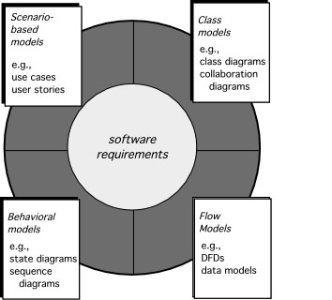
Modeling approaches

Slide 30
Scenarios
Scenarios are descriptions of how a system is used in practice
They are helpful in requirements elicitation as people can relate to these more readily than abstract statement of what they require from a system
Scenarios are particularly useful for adding detail to an outline requirements description

Slide 31
Scenario descriptions
System state at the beginning of the scenario
Normal flow of events in the scenario
What can go wrong and how this is handled
Other concurrent activities
System state on completion of the scenario

Slide 32
Event scenarios
Event scenarios may be used to describe how a system responds to the occurrence of some particular event such as ‘start transaction’
Convention for event scenarios.
Data provided and delivered
Control information
Exception processing
The next expected event

Slide 33
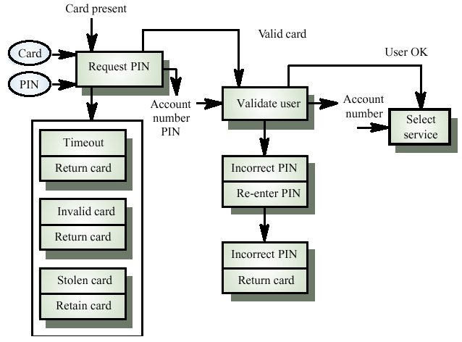
Event scenario - start transaction

Slide 34
Notation for data and control analysis
Ellipses. data provided from or delivered to a viewpoint
Control information enters and leaves at the top of each box
Data leaves from the right of each box
Exceptions are shown at the bottom of each box
Name of next event is in box with thick edges

Slide 35
Exception description
Most methods do not include facilities for describing exceptions
In this example, exceptions are
Timeout. Customer fails to enter a PIN within the allowed time limit
Invalid card. The card is not recognised and is returned
Stolen card. The card has been registered as stolen and is retained by the machine

Slide 36
Use-Cases
A collection of user scenarios that describe the thread of usage of a system
Each scenario is described from the point-of-view of an “actor”—a person or device that interacts with the software in some way
Each scenario answers the following questions:
Who is the primary actor, the secondary actor (s)?
What are the actor’s goals?
What preconditions should exist before the story begins?
What main tasks or functions are performed by the actor?
What extensions might be considered as the story is described?
What variations in the actor’s interaction are possible?
What system information will the actor acquire, produce, or change?
Will the actor have to inform the system about changes in the external environment?
What information does the actor desire from the system?
Does the actor wish to be informed about unexpected changes?

Slide 37
Use-Case Diagram

Slide 38
Class Diagram
From the SafeHome system …

Slide 39
State Diagram
Reading
Commands
State name
System status = “ready”
Display msg = “enter cmd”
Display status = steady
State variables
Entry/subsystems ready
Do: poll user input panel
Do: read user input
Do: interpret user input
State activities

Slide 40
4. Negotiating Requirements
Identify the key stakeholders
These are the people who will be involved in the negotiation
Determine each of the stakeholders “win conditions”
Win conditions are not always obvious
Negotiate
Work toward a set of requirements that lead to “win-win”

Slide 41
5. Validating Requirements - I
Is each requirement consistent with the overall objective for the system/product?
Have all requirements been specified at the proper level of abstraction? That is, do some requirements provide a level of technical detail that is inappropriate at this stage?
Is the requirement really necessary or does it represent an add-on feature that may not be essential to the objective of the system?
Is each requirement bounded and unambiguous?
Does each requirement have attribution? That is, is a source (generally, a specific individual) noted for each requirement?
Do any requirements conflict with other requirements?

Slide 42
Validating Requirements - II
Is each requirement achievable in the technical environment that will house the system or product?
Is each requirement testable, once implemented?
Does the requirements model properly reflect the information, function and behavior of the system to be built.
Has the requirements model been “partitioned” in a way that exposes progressively more detailed information about the system.
Have requirements patterns been used to simplify the requirements model. Have all patterns been properly validated? Are all patterns consistent with customer requirements?

Slide 43
Requirements validation
Concerned with demonstrating that the requirements define the system that the customer really wants
Requirements error costs are high so validation is very important
Fixing a requirements error after delivery may cost up to 100 times the cost of fixing an implementation error

Slide 44
Requirements checking
Validity. Does the system provide the functions which best support the customer’s needs?
Consistency. Are there any requirements conflicts?
Completeness. Are all functions required by the customer included?
Realism. Can the requirements be implemented given available budget and technology
Verifiability. Can the requirements be checked?

Slide 45
Requirements validation techniques
Requirements reviews
Systematic manual analysis of the requirements
Prototyping
Using an executable model of the system to check requirements. Covered in Chapter 8
Test-case generation
Developing tests for requirements to check testability
Automated consistency analysis
Checking the consistency of a structured requirements description

Slide 46
Requirements reviews
Regular reviews should be held while the requirements definition is being formulated
Both client and contractor staff should be involved in reviews
Reviews may be formal (with completed documents) or informal. Good communications between developers, customers and users can resolve problems at an early stage

Slide 47
Review checks
Verifiability. Is the requirement realistically testable?
Comprehensibility. Is the requirement properly understood?
Traceability. Is the origin of the requirement clearly stated?
Adaptability. Can the requirement be changed without a large impact on other requirements?

Slide 48
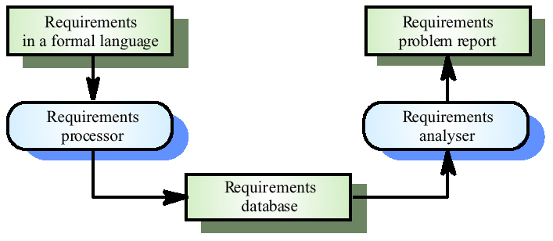
Automated consistency checking

Slide 49
6. Requirements management
Requirements management is the process of managing changing requirements during the requirements engineering process and system development
Requirements are inevitably incomplete and inconsistent
New requirements emerge during the process as business needs change and a better understanding of the system is developed
Different viewpoints have different requirements and these are often contradictory

Slide 50
Requirements change
The priority of requirements from different viewpoints changes during the development process
System customers may specify requirements from a business perspective that conflict with end-user requirements
The business and technical environment of the system changes during its development

Slide 51
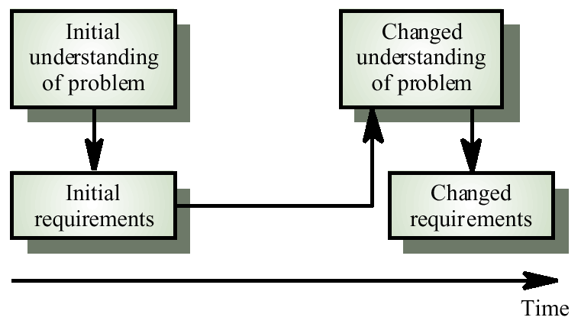
Requirements evolution

Slide 52
Enduring and volatile requirements
Enduring requirements: Stable requirements derived from the core activity of the customer organisation.
E.g. a hospital will always have doctors, nurses, etc. May be derived from domain models
Volatile requirements: Requirements which change during development or when the system is in use. In a hospital, requirements derived from health-care policy

Slide 53
Types of Volatile Requirements
Mutable requirements
Requirements that change due to the system’s environment
Emergent requirements
Requirements that emerge as understanding of the system develops
Consequential requirements
Requirements that result from the introduction of the computer system
Compatibility requirements
Requirements that depend on other systems or organisational processes

Slide 54
Requirements management planning
During the requirements engineering process, you have to plan:
Requirements identification
How requirements are individually identified
A change management process
The process followed when analysing a requirements change
Traceability policies
The amount of information about requirements relationships that is maintained
CASE tool support
The tool support required to help manage requirements change

Slide 55
Traceability
Traceability is concerned with the relationships between requirements, their sources and the system design
Source traceability
Links from requirements to stakeholders who proposed these requirements
Requirements traceability
Links between dependent requirements
Design traceability
Links from the requirements to the design

Slide 56
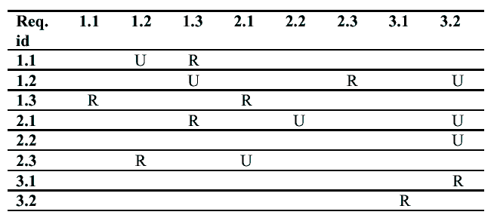
A traceability matrix

Slide 58
Traceability Process:
involves managing change:
Feature traceability: how requirements relate to observable system/product features
Source traceability: identifies source of each requirement
Dependency traceability: how requirements are related to each other
Subsystem traceability: categorizes requirements by the sub system (s) they govern
Interface traceability: how requirements relate to both external and internal system interfaces

Slide 59
CASE tool support
Requirements storage
Requirements should be managed in a secure, managed data store
Change management
The process of change management is a workflow process whose stages can be defined and information flow between these stages partially automated
Traceability management
Automated retrieval of the links between requirements

Slide 60
Requirements change management
Should apply to all proposed changes to the requirements
Principal stages
Problem analysis. Discuss requirements problem and propose change
Change analysis and costing. Assess effects of change on other requirements
Change implementation. Modify requirements document and other documents to reflect change

Slide 61
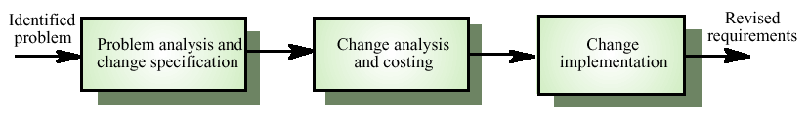
Requirements change management

Slide 62
b) List out Requirement Elicitation Techniques. Explain any two methods.

